Slide 1

Dedicated Mentoring System for Students (HEPro AI+)
Ummu Abeeba.S
AI/ML Project

Slide 2
The Challenge: Limitations of Traditional Mentoring
Lack of Personalization
Delayed Intervention
Resource Intensive
Generic advice often fails to address individual student needs, leading to disengagement and missed opportunities for growth.
Traditional methods struggle to identify students at risk early, often intervening only when academic or wellbeing issues become critical.
Manual mentoring processes are time-consuming and difficult to scale, limiting the number of students who can receive quality support.

Slide 3





Project Objectives: Revolutionizing Student Support
Multi-Dimensional Evaluation
Personalized Mentoring
Assess students across academic, wellbeing, productivity, and career dimensions for a holistic view.
Tailor mentorship strategies based on individual student profiles and identified needs.
Enhance Student Success
Data-Driven Decisions
Ultimately, to foster an environment where every student can thrive and reach their full potential.
Empower institutions with insights to make proactive and effective support decisions.

Slide 4

System Architecture: A Unified Approach
Data Layer
ML Segmentation
Scoring Engine
The Dedicated AI+ system integrates diverse data sources and advanced algorithms to provide a comprehensive and dynamic mentoring solution.

Slide 5
Dataset Overview: Fueling Intelligent Mentoring
Student Attributes
Mentor Dataset
Academic Performance: Grades, attendance, course completion.
Wellbeing Status: Engagement, stress levels, participation.
Productivity Metrics: Project deadlines, assignment submissions.
Career Aspirations: Interests, skills, industry preferences.
Expertise: Subject matter knowledge, industry experience.
Mentoring Style: Directive, facilitative, supportive approaches.
Availability: Open slots, preferred meeting times.
Feedback: Success rates, student satisfaction scores.

Slide 6
Scoring System: Quantifying Student Needs
Academic Performance Score (APS)
1
Measures scholastic achievement and progress.
Wellbeing & Wellness Score (WWS)
2
Assesses mental and physical health indicators.
Productivity & Time Management Score (PTMS)
3
Evaluates efficiency and organizational skills.
Career Readiness Score (CRS)
4
Indicates preparedness for future career paths.
Student Readiness Index (SRI)
A composite score providing an overall student health snapshot.

Slide 7
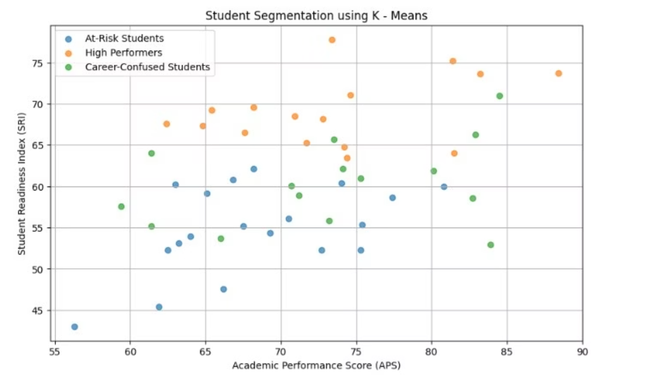
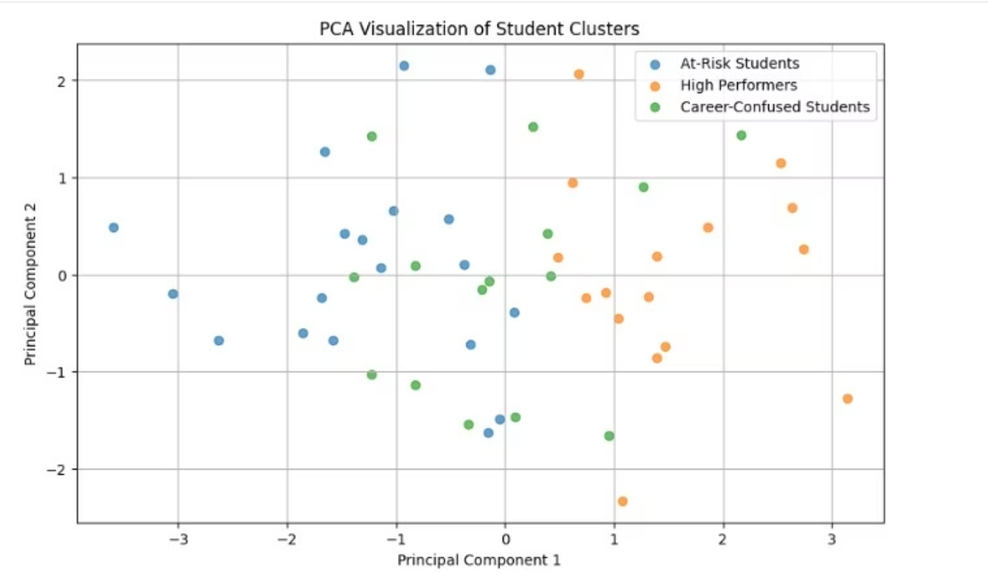
Machine Learning Model: K-Means Clustering
K-Means Clustering (K=3)
An unsupervised algorithm groups students into distinct segments based on their scores.
Feature Scaling
Standardizes data to ensure all features contribute equally to the clustering process.
PCA Visualization
Principal Component Analysis reduces dimensionality for intuitive 2D or 3D visualization of student clusters.

Slide 8



Student Segments: Tailored Support for Every Profile
At-Risk Students
Career-Confused Students
High Performers
Identified by lower APS, WWS, and PTMS. Require immediate, focused interventions to prevent academic decline.
Exhibit strong scores across all dimensions. Need advanced challenges, leadership opportunities, and specialized guidance to maximize potential.
Characterized by lower CRS scores and uncertain career goals. Benefit from career counseling and exposure to various professional fields.
Cluster Count: 120
Cluster Count: 80
Cluster Count: 200

Slide 9



Mentor Matching: The Perfect Pair
Cosine Similarity
Style Compatibility
Availability & Capacity
Matches mentors and students based on shared interests, expertise, and needs, ensuring a strong foundational connection.
Considers mentoring approach (e.g., directive, supportive) to align with student learning preferences for optimal engagement.
Optimizes scheduling and mentor workload, ensuring sustainable and effective mentorship relationships.

Slide 10
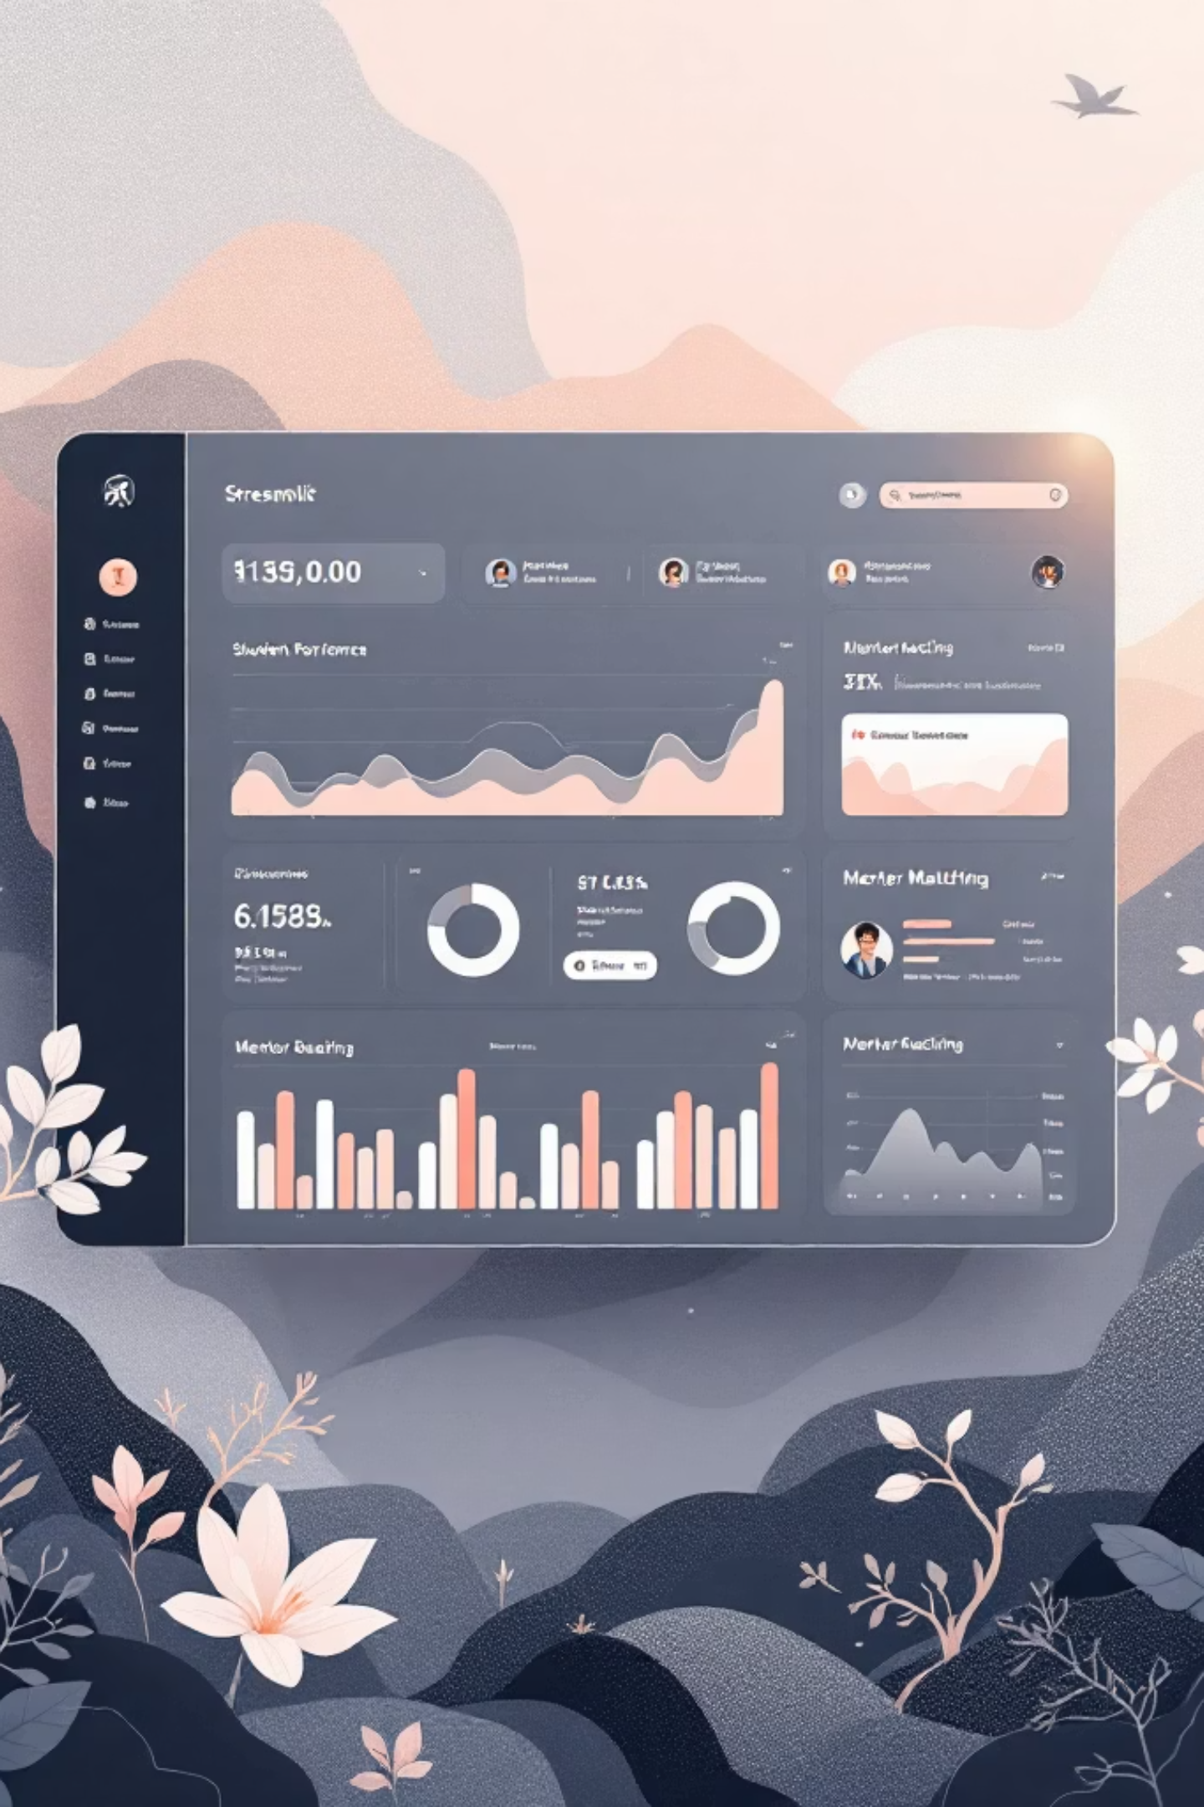
Streamlit Dashboard: Intuitive Insights
Overview
Student Analysis
A high-level summary of all student segments and overall system performance.
Detailed drill-downs into individual student profiles, scores, and recommendations.
Feedback Monitoring
Tracks mentor-mentee interactions and satisfaction to continuously refine the system.

Slide 11
